Slide 1
Autonomous Mobile Robots
Control and Planning: Autonomous Mobile Robots and Autonomous Vehicles
Aliasghar Moj Arab

Slide 2
Lecture 4
P A R T 0 1
Nonlinear Control Methods

Slide 3
Topics
Introduction & Physical Constraints
Vehicle Kinematics & Equations of Motion
Control & Perception Fundamentals
Nonlinear Control Methods
Advanced Model Predictive Control (NMPC) + Constraints
Motion Planning Algorithms (RRT*, RRT, DWA, path generation)
Learning-Based Planning & Control
Industry Standards, Architectures, & Safety

Slide 4
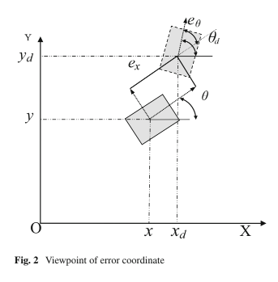
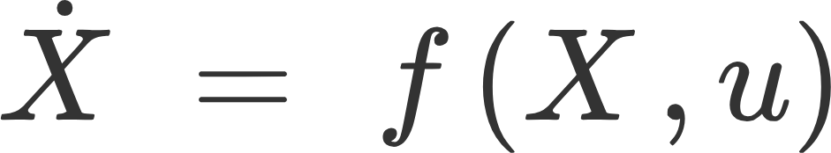
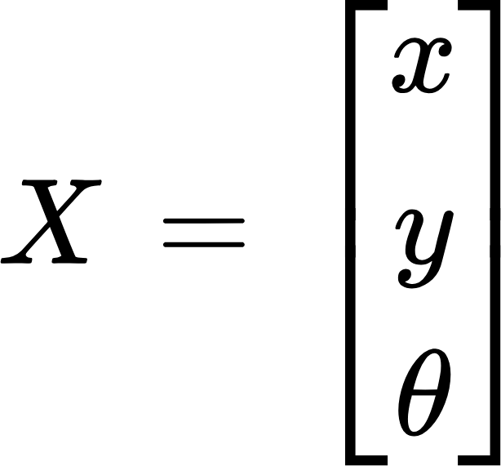

Designing a Controller
We are Modelling a nonlinear, time-invariant system:
Where:
Robot state =
Control Input

Slide 5

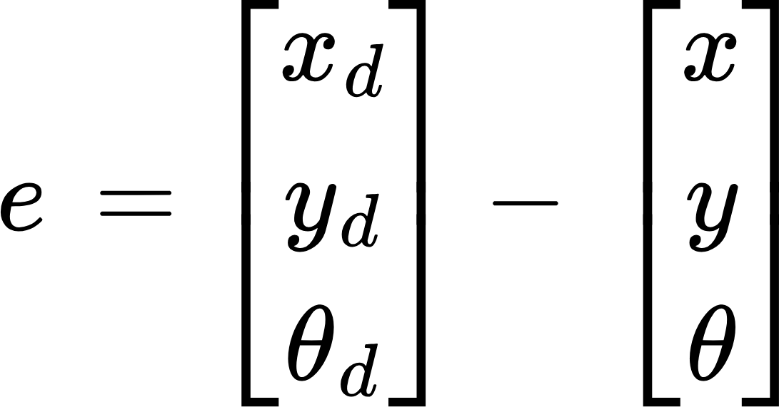
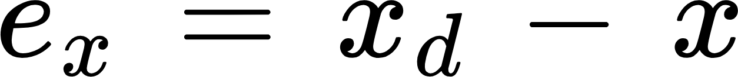
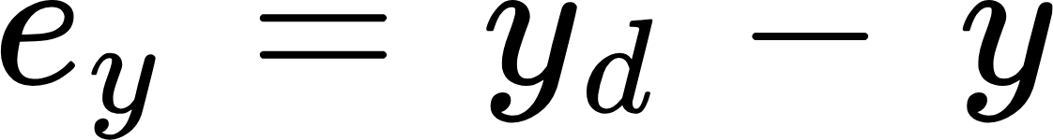
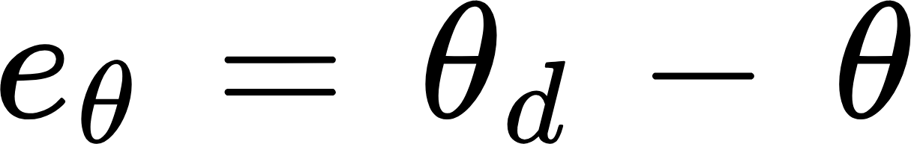
Error Definition
Define the vector as :
Difference along x-axis
Difference along x-axis
Difference in Heading

Slide 6
Things to focus on while designing a controllet
Stable
Optimal
Robust
Adaptive
Efficient
Low cost

Slide 7
Independent Wheel Control
Pros | Cons
Multiple PI controllers (straightforward loop design) Works well with ROS kinematic frameworks Scalable (can extend to more wheels) Simple at the kinematic level | Lacks deeper physical/dynamic understanding Doesn’t capture full robot dynamics More sensors required (encoders per wheel) Adds dynamic complexity at higher levels

Slide 8
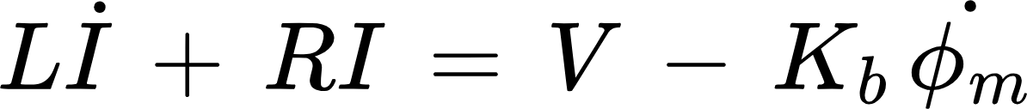
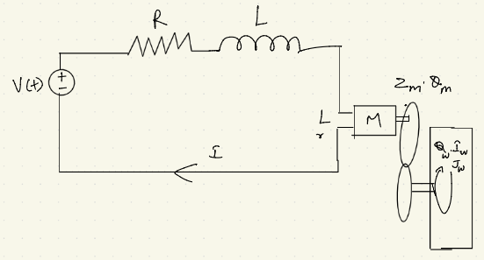




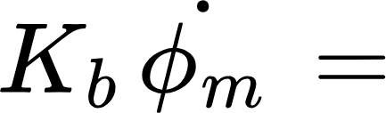
Motor Electrical Dynamics
applied motor voltage
current in motor coil
coil resistance
coil inductance
back EMF opposing the voltage

Slide 9
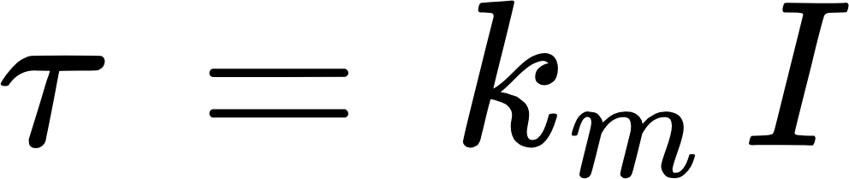

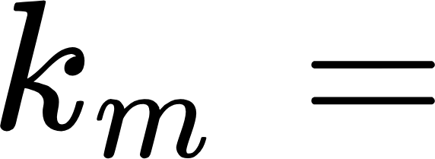

Torque
motor torque constant
motor current

Slide 10
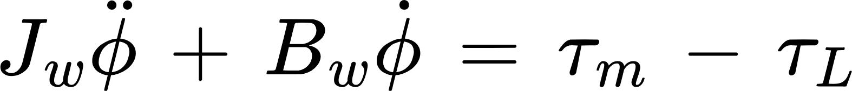
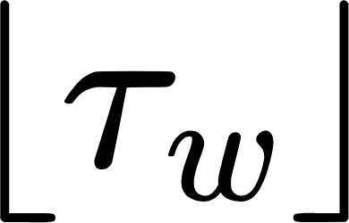
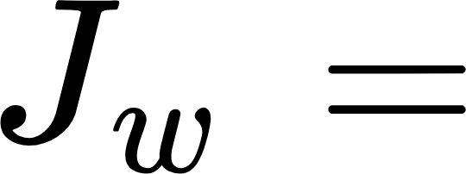
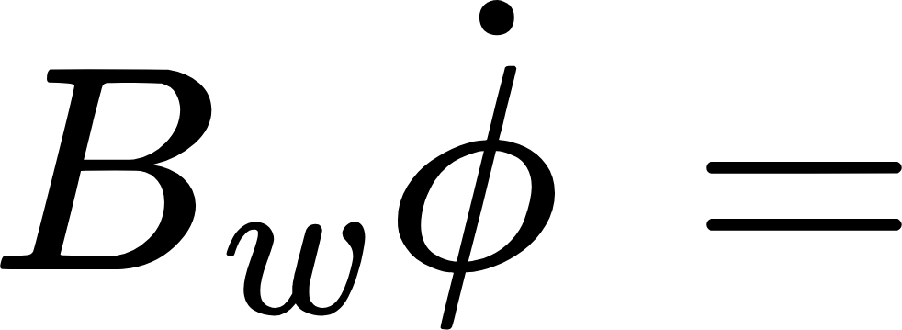


Wheel Mechanical Dynamics
wheel inertia
viscous damping (friction at bearings, etc.)
load torque (from robot weight, ground resistance)
torque from motor

Slide 11
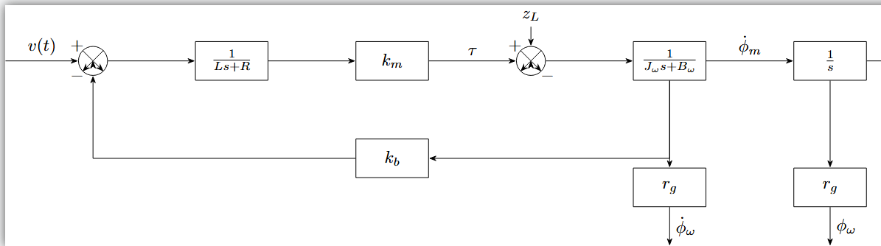
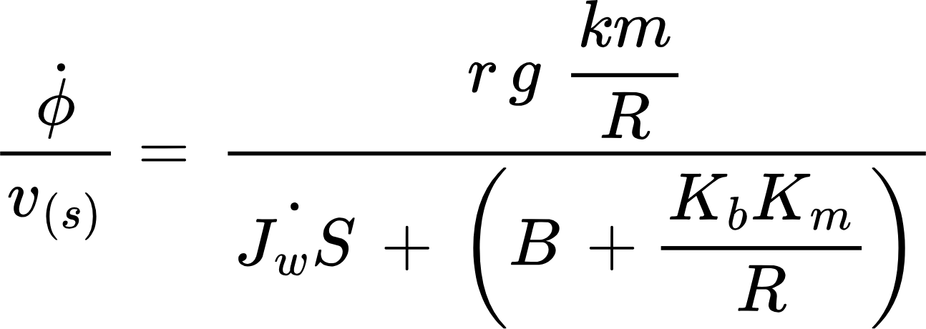
Transfer Function
A first-order system between voltage and wheel speed:

Slide 12
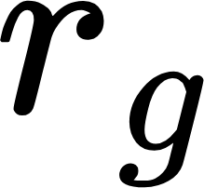


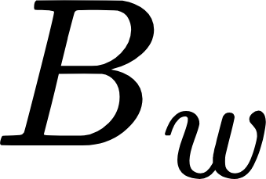
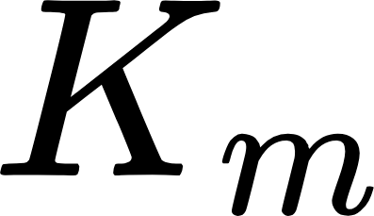
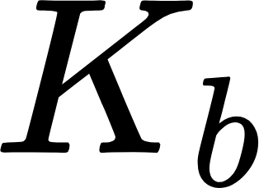
Transfer Function
: gear ratio
: electrical resistance
​: wheel inertia
: damping
: torque constant
: back-EMF constant

Slide 13

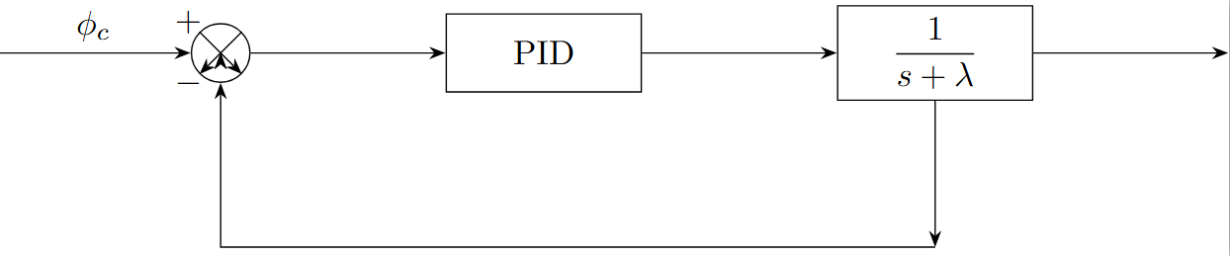
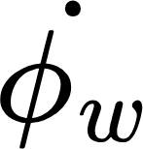
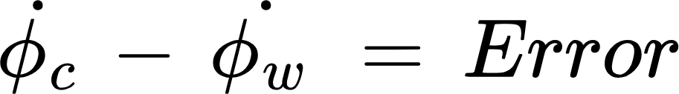
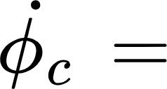
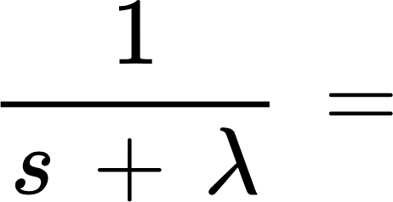
Wheel Speed Control with PID
Desired wheel speed
Approximated wheel + motor dynamics (first-order response)

Slide 14
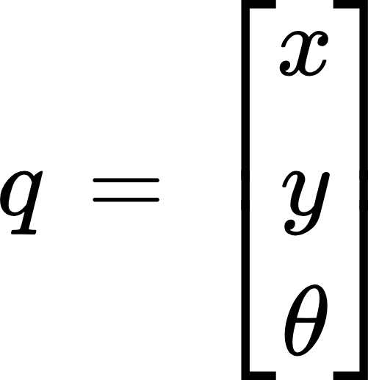
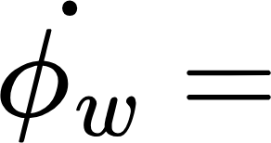
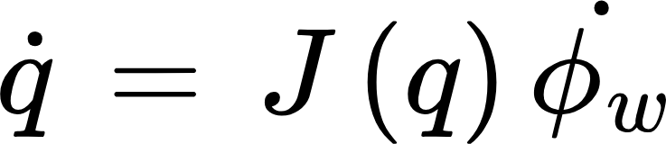
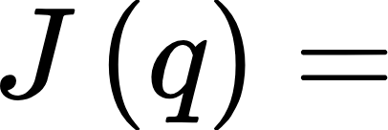
Wheel Speed to robot motion
Robot Pose :
Wheel angular velocities
Relation:
Jacobian that maps wheel speeds to robot body velocities

Slide 15
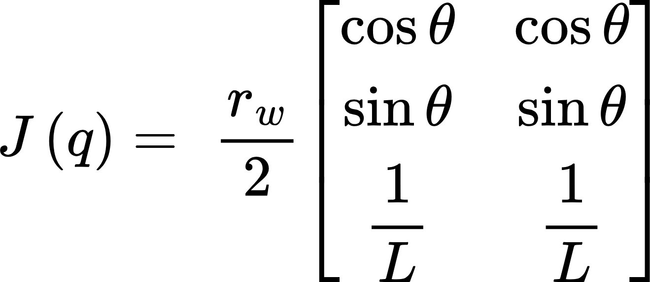
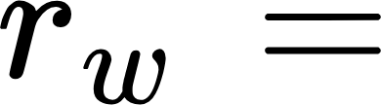

Jacobian for Differential Drive
wheel radius
half the wheelbase (distance from center to wheel)

Slide 16
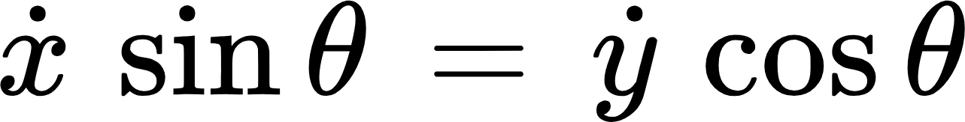
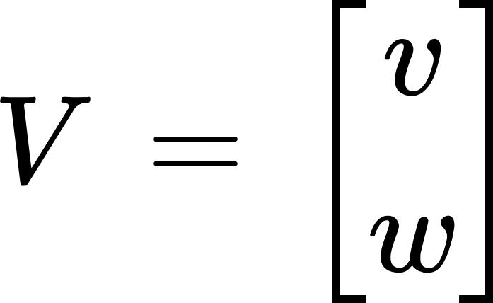
Nonholonomic Constraint
Robot cannot move sideways (no velocity in body-y direction).
This reduces motion to two DOFs:
Linear velocity v
Angular velocity ω

Slide 17

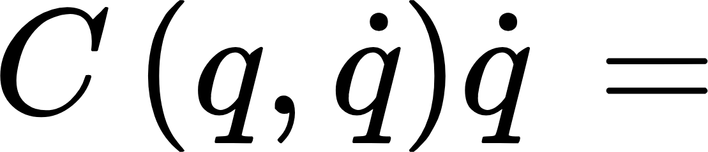

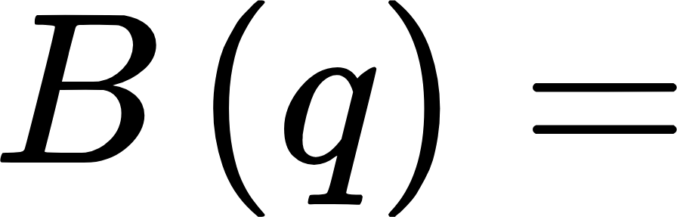

Robot Dynamic Model
General dynamic equation of mobile robot:
inertia (mass) matrix
Coriolis / centrifugal matrix
disturbances (friction, external forces)
input mapping matrix
Wheel torques

Slide 18
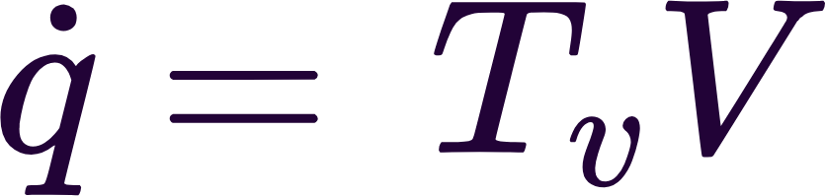
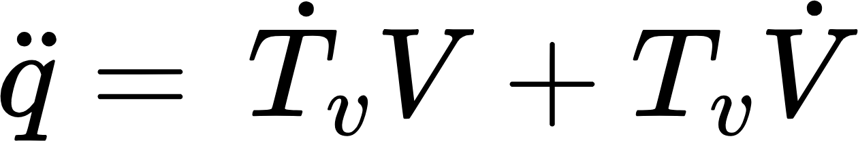
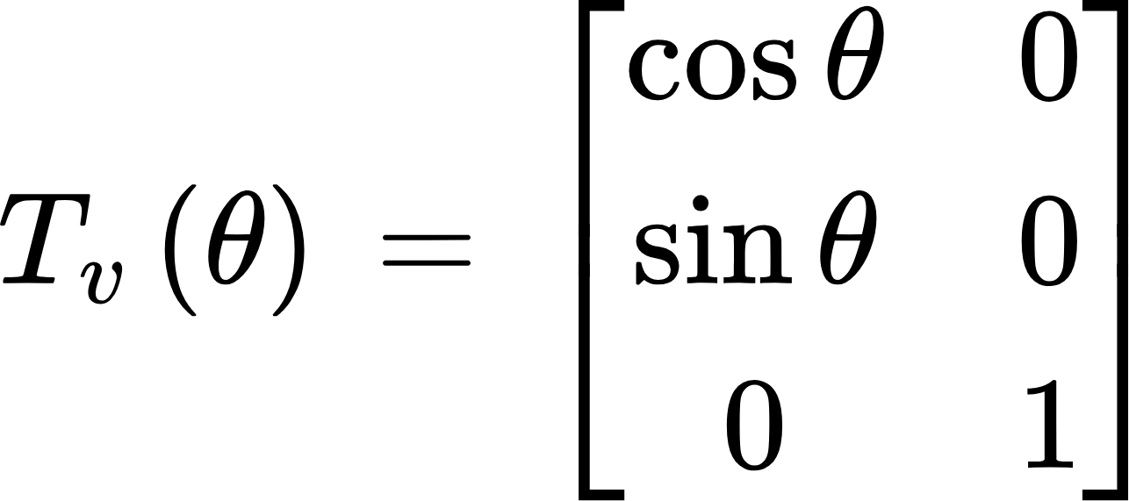
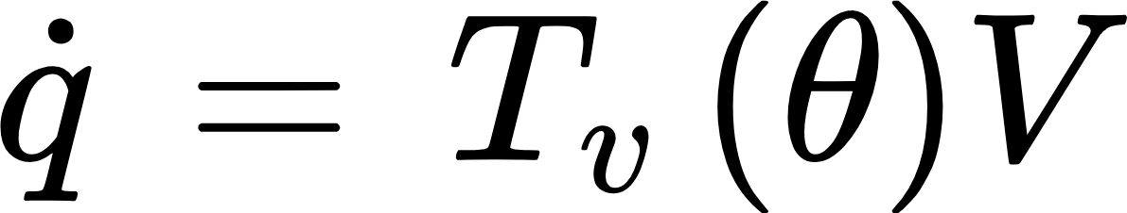
Inertia and Coriolis Matrices
Transformation Relations

Slide 19
Inertia and Coriolis Matrices
Transformation Relations

Slide 20
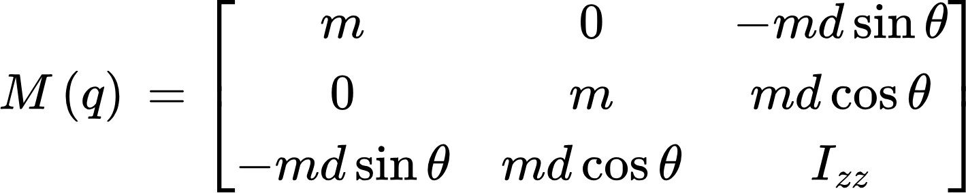
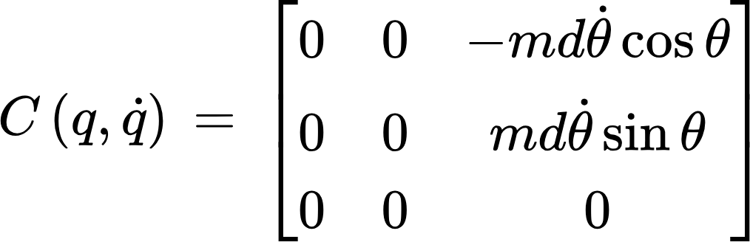
Inertia and Coriolis Matrices
Inertia Matrix:
CoriolisMatrix:

Slide 21
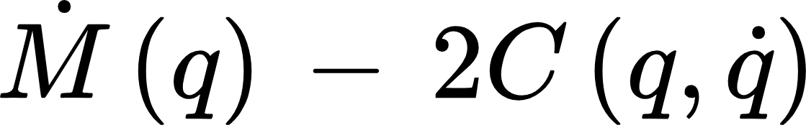


Property of Robot Dynamics
A Skew Symmetric Matrix
This equation guarantees energy conservation in robot dynamics
Useful in proving stability for control design (Lyapunov methods)

Slide 22
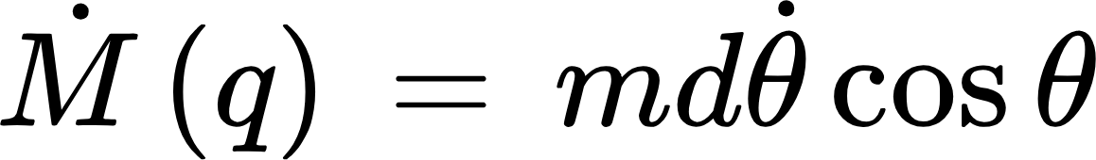
Finding the EOM of the robot

Slide 23
Finding the EOM of the robot
Substituting relations into the EOM:
Expand & reorganize:

Slide 24
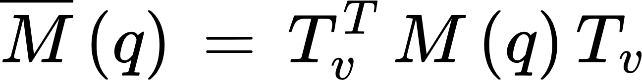
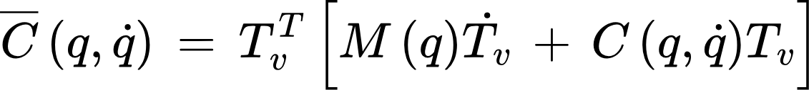
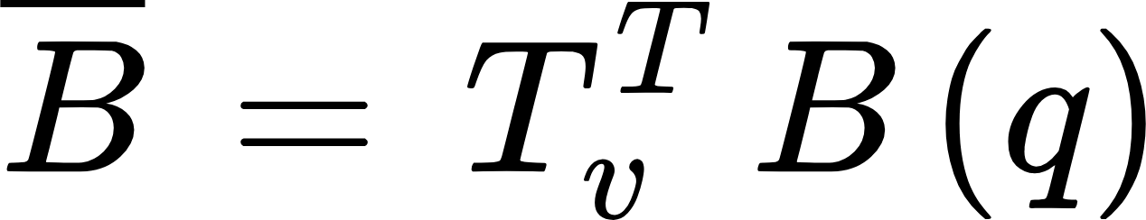
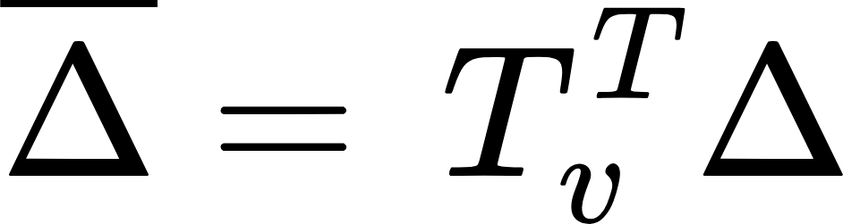
Final Velocity-Space Dynamics

Slide 25
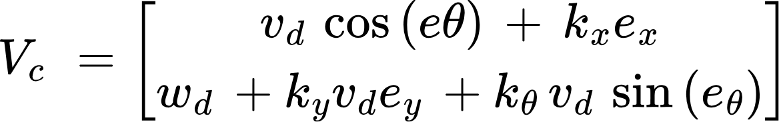

Command velocity V_{c}
Equation for control input:
Doesn’t follow set point
Works for trajectory following
Desired position + Velocity

Slide 26

Overall Control Structure
Input: desired trajectory (q_{d},v_{d})
Kinematic Controller → computes command velocity v_{c}​ based on tracking errors
Dynamic/Independent Wheel Controller → converts v_{c} into wheel torques τ
Robot + EOM → updates motion states q,q˙​)
Feedback transform → converts robot states back into error signals for correction

Slide 27



Feedback Linearization
Robot velocity dynamics:
Input Torque:
Desired: robot velocity :
Model:

Slide 28


Linearization Idea (general system)
Nonlinear system:
Choosing Control law:
By substituting:
Error Dynamics:

Slide 29


Control Law for the Robot
Apply Feedback Linearisation to velocity-space EOM
Chosen input torque:
Substituting 2 in 1

Slide 30




Closed-Loop Error Dynamics
Define:

Slide 31


Second-Order Error Dynamics
With position error:
Characteristic equation:

Slide 32



Set-Point Control
Goal: stabilize robot at a desired position (x_{d},y_{d})
Instead of directly controlling (x,y,θ) define a virtual output

Slide 33



Set-Point Control
Goal: stabilize robot at a desired position (x_{d},y_{d})
Instead of directly controlling (x,y,θ) define a virtual output

Slide 34
Control Law
Substitute into velocity-space dynamics

Slide 35

Second-Order Error Dynamics
With position error:

